Slide 1
Data Platforms - A 3D View
Manuele Pasini
manuele.pasini@unibo.it
09/12/2025
Slides at: tinyurl.com/dataplatseminar
Intro
Who am I ?
Manuele Pasini, Ph.D. Candidate in Computer Science and Engineering
University of Bologna, Business Intelligence Group
Area of Interest:
(Almost) the whole data* world.
Data engineering;
Data integration;
Precision Agriculture:
Irrigation management;
Data Platform for italian agriculture domain @Agritech.
A case study - The Agritech PNRR Project
Goal: Build a data platform to foster collaboration and integration between different agriculture research projects.

Slide 2
In short:
6 research partners;
multidisiplinary projects;
different goals;
Considerations:
Requirements might not always be clear;
analysis goals could evolve through time!
Main challenges:
Data governance;
Resource governance;
Unforseen events.
Agritech project

Slide 3
About Governance…
Requirement gathering
We needed to identify key data aspects!
Process:
Two meetings with each partner;
Questionaire filling;
10 minutes presentation on their project;
Clear questions on the type of data managed.
Desired output: document key data aspects (5Vs) and processing requirements (e.g., GPUS) for each stakeholder.
About Governance…

Slide 4
Output
Domain analysis:
Project volatility;
non-communicating partners;
data shattered through different formats;
no common ground for interoperability.
Identified data aspects:
Variety: vector, image, multispectral, and sensor data.
Volume: from small sensor data to large drone missions.
Veracity: manual collection and sharing.
Strong temporal and spatial connotations.
Agritech project

Slide 5
Towards a mesh architecture

Slide 6
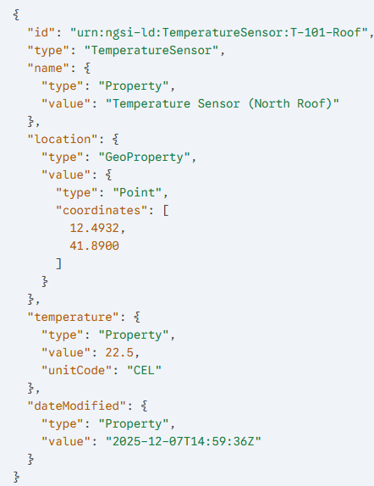
Centralized integration would be a nightmare!
1 ETL procedure x stakeholder;
hard to enforce data quality;
limited scalability (w.r.t. stakeholders).
Hybrid solution:
Centralized storage;
Governance through adherence to FIWARE Smart Data Models;
JSON descriptor attached to data;
Common glossary of terms (e.g., AGROVOC);
geo-properties standardization.
Stakeholder responsible of quality adherence;
Data as a product!
FIWARE Agrifood Smart Data Model example

Slide 7
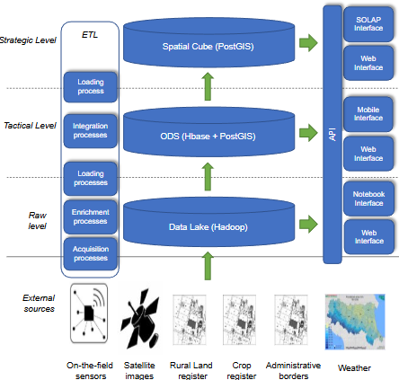
Agritech architecture
Agritech Conceptual Architecture
Agritech functional architecture

Slide 8
Before talking deploy, we have a problem!
Someting came up, we need to think about a migration first… Slides at: tinyurl.com/dataplatmigration

Slide 9
Now let’s talk deploy!
On a hardware level

Slide 10
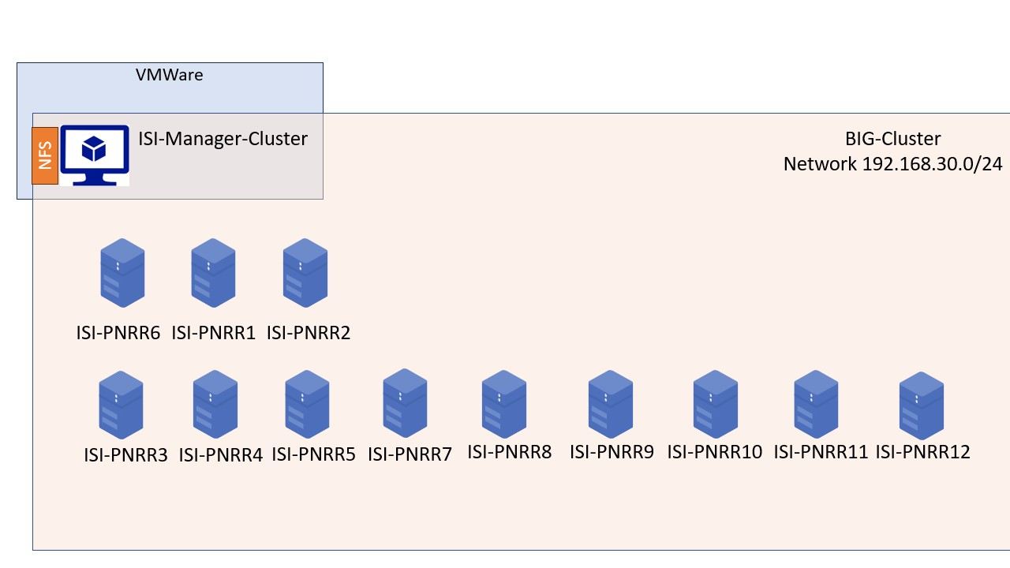
12 nodes (and counting…)
CPU 20 core w5-2445 @4.6 GHZ
256 GB RAM
12 TB HDD
2 GPUs NVIDIA RTX 6000 Ada Generation
1 Network File System (3 TB)
Hardware architecture

Slide 11
On a hardware level

Slide 12
We don’t really want to work on bare metal…
Need to build fault tolerance mechanisms;
Need to build monitoring tools;
Probable dependency issues;
no isolation .
… We want to virtualize
remember the independence constraint.
Docker (or Kubernetes in production environments)!
Hardware + Docker architecture
Hardware + Docker architecture

Slide 13
A Docker overview
Docker is a platform for developing, shipping and running isolated application using container based virtualization technology.

Slide 14

w.r.t. virtual machines (e.g., VMWare):
more lightweight;
no guest OS;
reduced resource consumption;
more containers per host;
greater portability.
Container vs. Virtual Machines

Slide 15
Docker Swarm
Swarm mode is an advanced feature for managing a cluster of Docker daemons.

Slide 16
Characteristics:
Integrated Orchestration;
multi-host networking;
load balancing;
scaling features;
service discovery;
rolling updates.
Docker swarm architecture

Slide 17
Building a Data Platform
Platform services as Docker services.
Logically organized in stacks, manageable throguh Portainer.

Slide 18
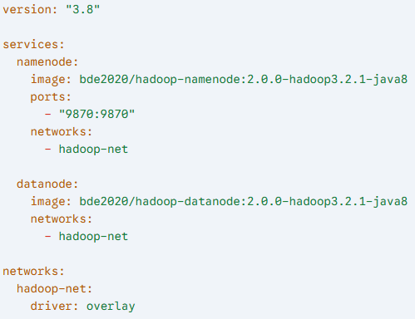
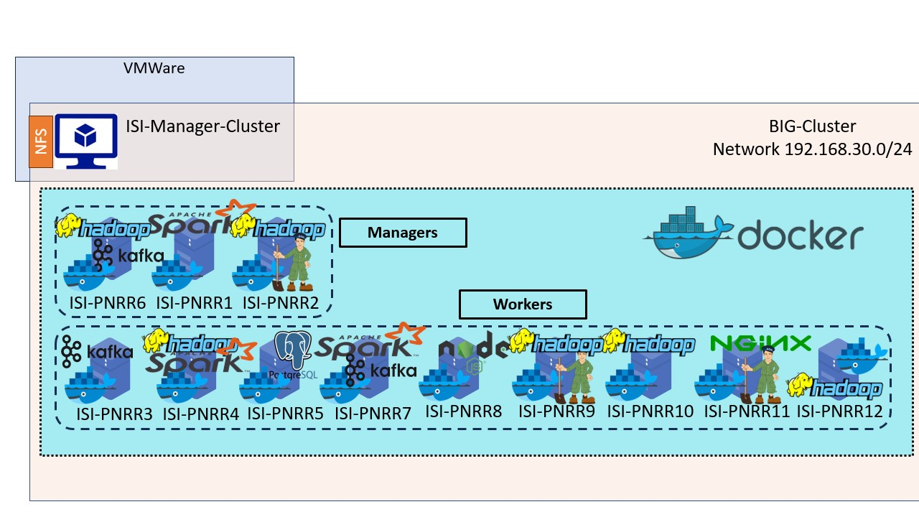
Docker swarm architecture
Docker stack example

Slide 19
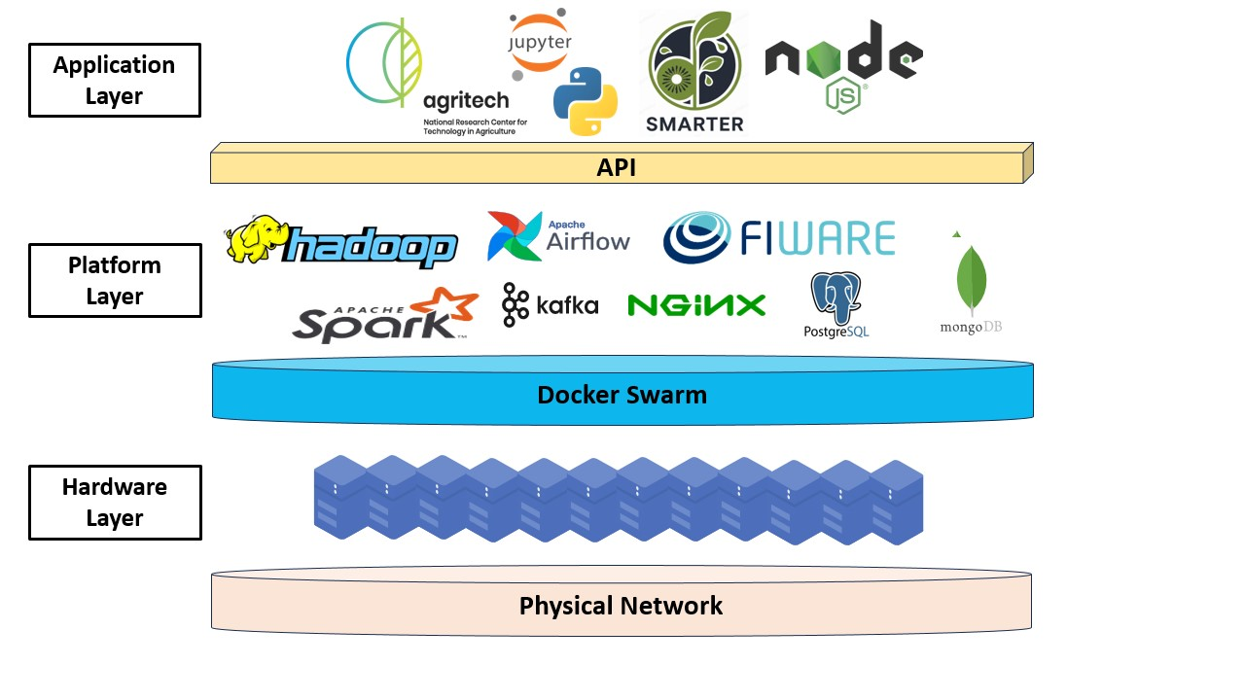
This is the what, but…
… Too many things in one-flat schema, we need to add another dimension.
A perspective change - Vertical View
Portainer grants you access from the top…
SSH on phisical machines grants access from the bottom.
Now we know the where…
What about the how ?
Connecting the wires - Functional View
Vertical view

Slide 20
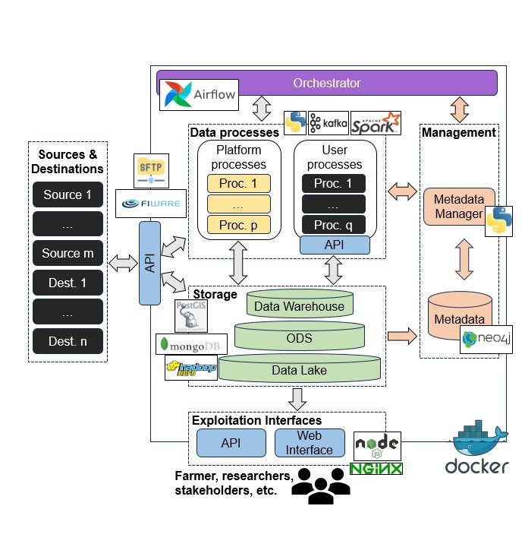
Processing Module:
Platform processes: internal to the platform, used for providing users tools&data (e.g. download SENTINEL-2 images)
User processes: specific to a user (e.g. UniPR), black-box to the platform. Interact through APIs.
Metadata Module: Support governance policies (e.g., FIWARE)
Storage Module: Heterogeneous and hierarachical set of storage systems (e.g., Hadoop, MongoDB, PostgreSQL)
APIs Module: defines how users interacts with the platform services.
Apache Airflow as platform quarterback!
Functional view

Slide 21
Let’s put things toghether
A bigger version
SMARTER - Irrigation optimization of fruit orchards
Agritech - A Data Platform for Italian Precision Agriculturew
Agritech - Towards further structure
Data Platform as a whole
Smart Irrigation Data Pipeline
Agritech actual functional view
Agritech future functional view

Slide 22
Thanks!
Questions?

